Slide 1

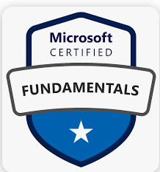
Azure Fundamentals (AZ-900)

Slide 2

Day -6 Azure management and governance

Slide 3
Outlines
Azure cost management
Azure Management Tools
Azure for governance and compliance
Azure Monitoring Tools
AZ 900 Exam Details

Slide 4
Azure cost management
Factors that can affect costs in Azure
Pricing and Total Cost of Ownership (TCO) Calculator
Azure Cost Management Tool
Purpose of Tags
© 2023 Trellance, Inc. All rights reserved.

Slide 5
Cost Factors
The OpEx cost can be impacted by many factors including
Resource type
Consumption
Maintenance
Geography
Subscription type
Azure Marketplace
Notes:
Examples : VMs and Storage accounts
Pay as you go and reservations
Remove unwanted resource dependenses

Slide 6
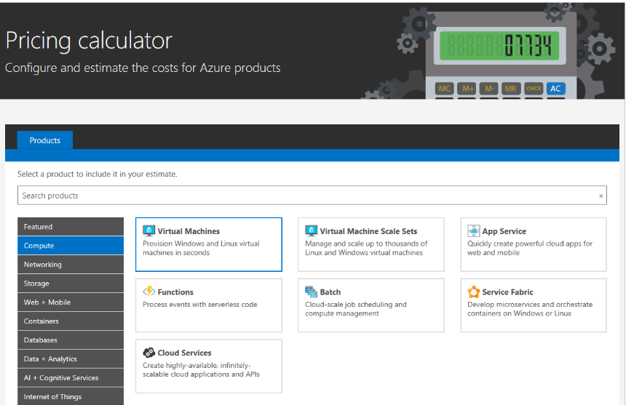
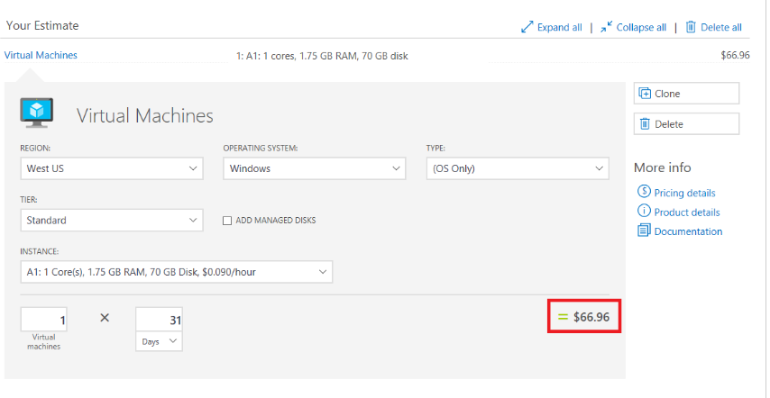
Pricing Calculator
Pricing Calculator : Is designed to give you an estimated cost for provisioning resources in Azure.
Notes:
https://azure.microsoft.com/en-in/pricing/calculator/

Slide 7
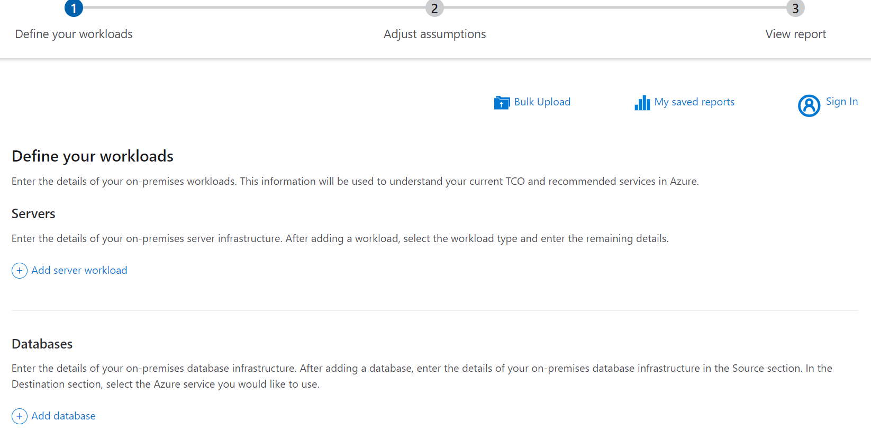
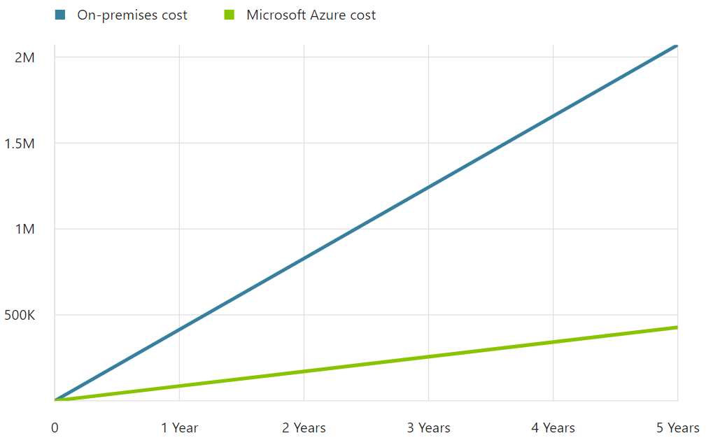
TCO Calculator
The TCO calculator is designed to help you compare the costs for running an on-premises infrastructure compared to an Azure Cloud infrastructure
.
Notes:
The TCO Calculator helps you understand the cost areas that affect your applications today, such as server hardware, software licenses, electricity, and labor.
Estimate the cost savings you can realize by migrating your workloads to Azure
https://azure.microsoft.com/en-in/pricing/tco/calculator/

Slide 8
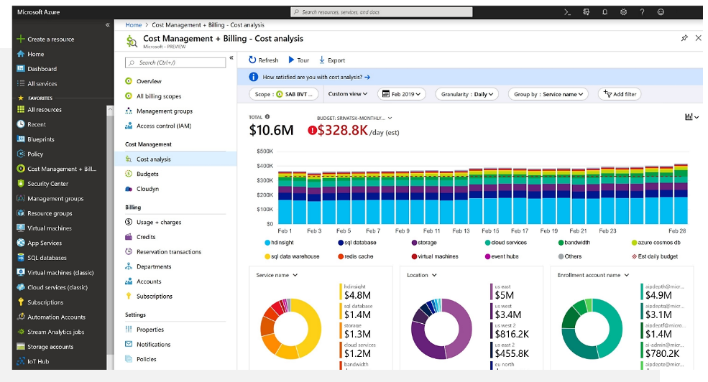
Cost Management Tool
Cost Management provides the ability to quickly check Azure resource costs, create alerts based on resource spend, and create budgets that can be used to automate management of resources.

Slide 9
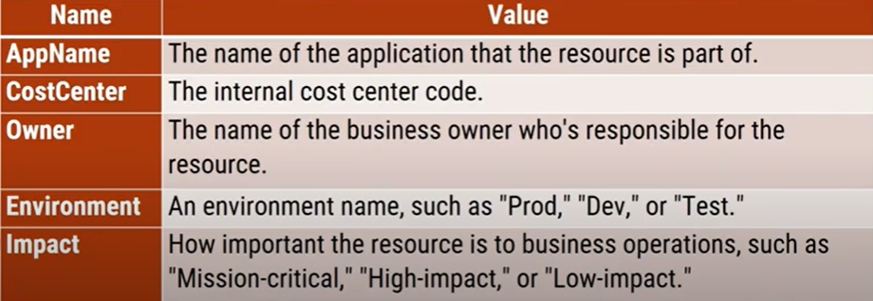
Purpose of Tags
In Order to manage the resources, we can resource groups, Resource tags are another way to organize resources.
Tags provide extra information, or metadata, about your resources.

Slide 10
Azure Management Tools
Azure Portal
Azure Cloud Shell
Azure Mobile App
Azure Arc
Azure Resource Manager [ARM]
Azure ARM Templates
© 2023 Trellance, Inc. All rights reserved.

Slide 11
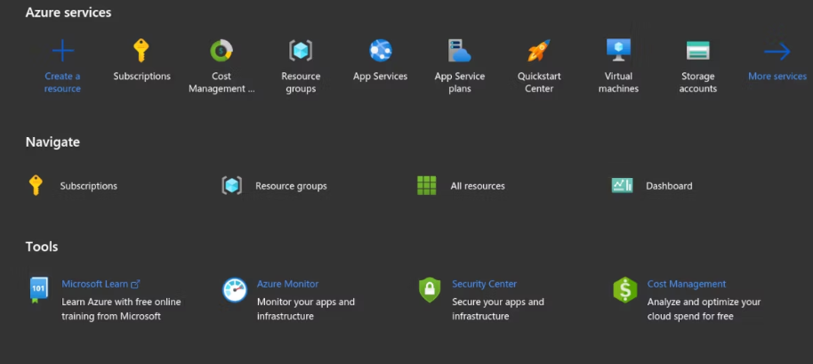
Azure Portal
It is a web-based, unified console that provides an alternative to command-line tools.
With the Azure portal, you can manage your Azure subscription by using a graphical user interface.

Slide 12
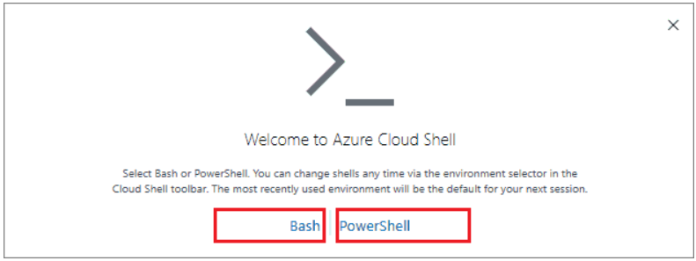
Azure Cloud Shell
It is a browser-based shell tool that allows you to create, configure and manage Azure resources using a shell.
Azure Cloud Shell support both Azure PowerShell and the Azure Command Line Interface(CLI), which is a Bash shell.

Slide 13
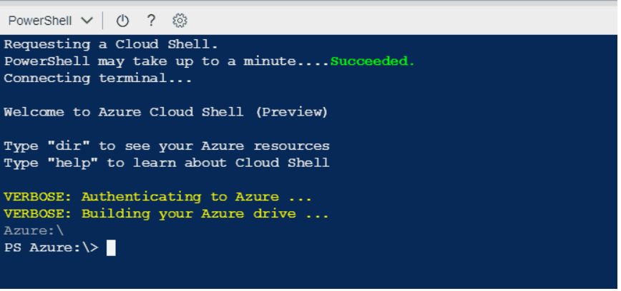
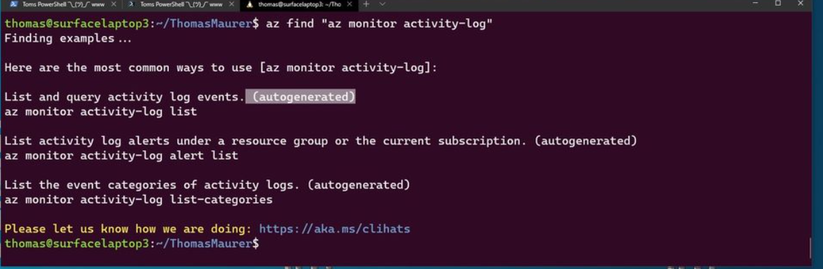
Azure PowerShell and CLI
PowerShell is a shell with which developers, DevOps, and IT professionals can run commands called command-lets(cmdlets).
CLI : CLI is functionally equivalent to Azure PowerShell, with the primary difference being the syntax of commands.
CLI is a command-line tool for provisioning and managing Azure resources from the terminal.

Slide 14
Azure Mobile App
The Microsoft Azure mobile app allows you to access, manage, and monitor all your Azure accounts and resources from your iOS or Android phone or tablet.
Once installed, you can perform various azure tasks

Slide 15
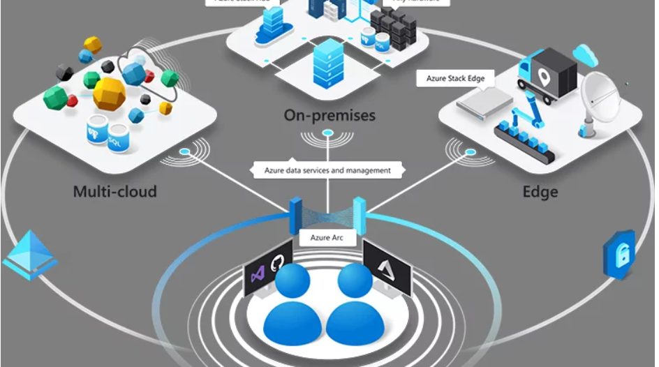
Azure Arc
Azure Specific Solution for Hybrid Cloud : Azure Arc
Manage multi cloud and on-premise infrastructure from one place
Supports Centralized management of VMware resources, Kubernetes clusters, SQL Server instances, on-premise physical and virtual machines
Notes:
Microsoft is extending the hybrid cloud management technologies to Linux and Windows server platforms and Kubernetes clusters running on any infrastructure. With Azure Arc, users can deploy, manage and secure apps and run data services in their own servers, multiple cloud platforms, and edge computing scenarios to the connected devices in the remote locations.
https://www.youtube.com/watch?v=HwmRsDRuskk&ab_channel=ConceptsWork

Slide 16
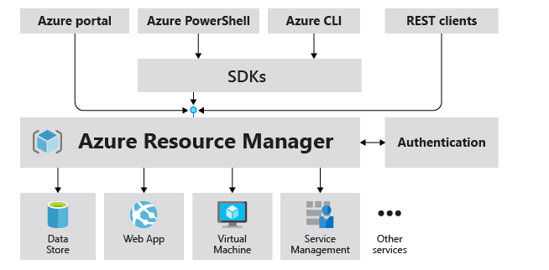
Azure Resource Manager
Azure Resource Manager is the deployment and management service for Azure.
It provides a management layer that enables you to create, update, and delete resources in your Azure account.
You use management features, like access control, locks, and tags, to secure and organize your resources after deployment.
Notes:
https://learn.microsoft.com/en-us/azure/azure-resource-manager/management/overview

Slide 17
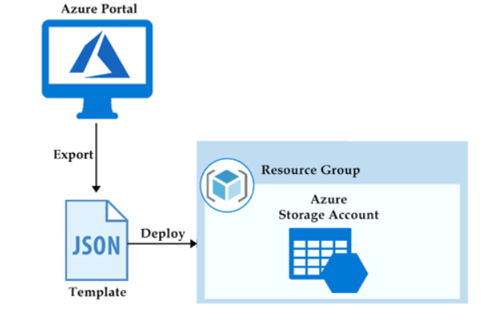
ARM Template
Infrastructure as code (IaaC) is a concept where you manage your infrastructure as lines of code.
Define resources in a JSON file
Leveraging Azure Cloud Shell, Azure PowerShell or CLI are some examples of using code to deploy cloud infrastructure.

Slide 18

Quiz
1. You are planning to build your own data center. Cost of building your own data center comes under
a) CapEx b) OpEx
2. Your enterprise is running your own data center. Paying electricity bill and operating cooling towers for your
data center comes under ------
a) CapEx b) OpEx
3. Which of these helps you estimate the cost savings you get by migrating your workloads to Azure?
a) TCO Calculator b) Pricing Calculator c) Pay as you go model
4. True or False : Price of Azure VMs can vary from region to region
a) True b) False
5. Inbound data transfer from on-premises to Azure is Not free
a) True b) False

Slide 19
Azure for Governance and Compliance
Azure Blueprint
Azure Policy
Resource Locks
Azure Service Trust Portal
© 2021 Trellance, Inc. All rights reserved.

Slide 20
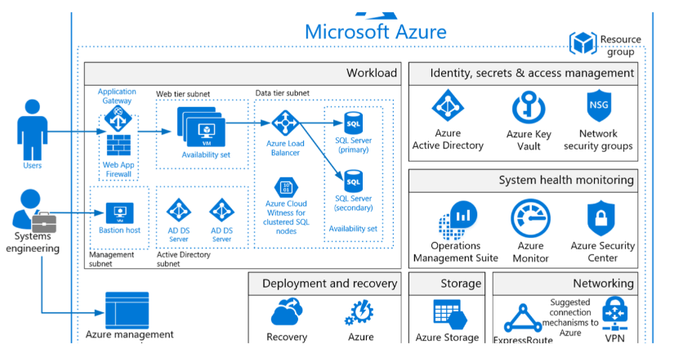
Blueprint
By using Azure Blueprints, you can orchestrate the deployment of resource templates and other Azure artifacts, including role assignments, policy assignments, resource groups and resource manager templates.
Artifacts : Each component in the blueprint definition is known as an artifact.

Slide 21

Azure Policy
Azure Policy is a service in Azure that enables you to create, assign and manage policies that control or audit your resources.
These policies enforce different rules across your resource configurations so that those configurations stay compliant with corporate standards.
Azure Policy initiatives : An Azure Policy initiative is a way of grouping related policies together. The initiative definition contains all of the policy definitions to help track your compliance state for a larger goal.

Slide 22
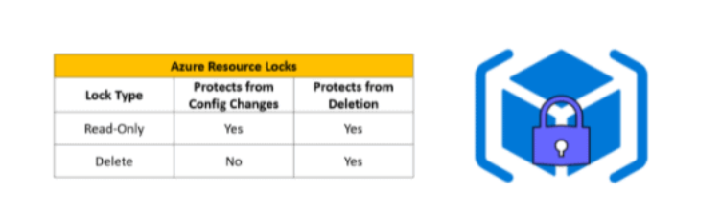
Resource Locks
A resource lock prevents resources from being accidentally deleted or changed.
Resource locks can be applied to individual resources, resource groups or even an entire subscription.
Azure has basically two kinds of locks known as read-only and deletes locks.

Slide 23

Azure Service Trust Portal
Learn how Microsoft cloud services protect your data, and how you can manage cloud data security and compliance for your organization.
You can access the Service Trust Portal at https://servucetrust.microsoft.com/
Offering the below ones
Service Trust Portal
My Library
All Documents
Notes:
Service Trust Portal provides a quick access hyperlink to return to the Service Trust Portal home page.
My Library lets you save (or pin) documents to quickly access them on your My Library page. You can also set up to receive notifications when documents in your My Library are updated.
All Documents is a single landing place for documents on the service trust portal. From All Documents, you can pin documents to have them show up in your My Library.

Slide 24
Quiz
1. You can manage compliance of resources across multiple subscriptions using-------
a) Resource groups b) Azure Policy c) Azure Rights management
2. True or False : You can prevent accidental deletion of resources by adding a Delete Lock
a) True b) False
3. True or False : A resource can have multiple read or delete locks
a) True b) False
4. You do not want to allow creation of an Azure Cosmos DB instances in specific resource
groups. Which of these options would you recommend?
a) Resource Group Lock b) Request Azure Customer service c) Configure an Azure policy

Slide 25
Azure Monitoring Tools
Azure Cloud Advisor
Azure Service Health
Azure Monitor
Notes:
https://www.youtube.com/watch?v=zWTyR1zl59Q

Slide 26
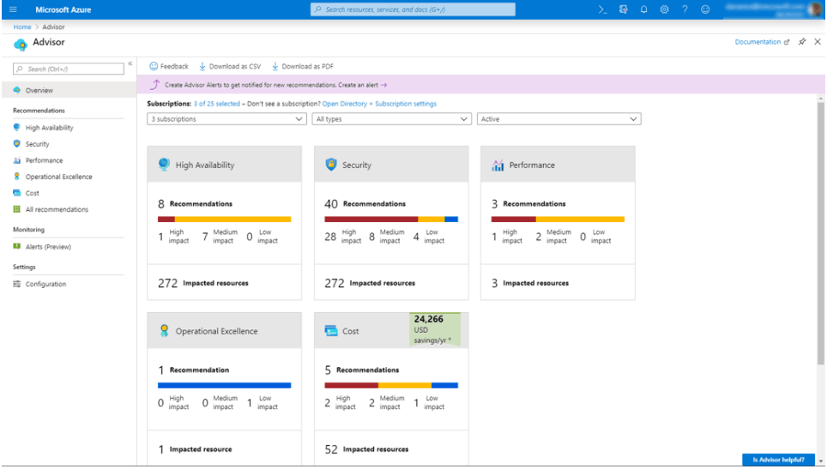
Azure Cloud Advisor
Automated recommendations to help improve reliability, Security and performance, achieve operational excellence and reduce costs on resources
Support notifications for new recommendations.
Gives you Total Score
Azure Advisor is Free of Cost
Examples for recommendations

Slide 27
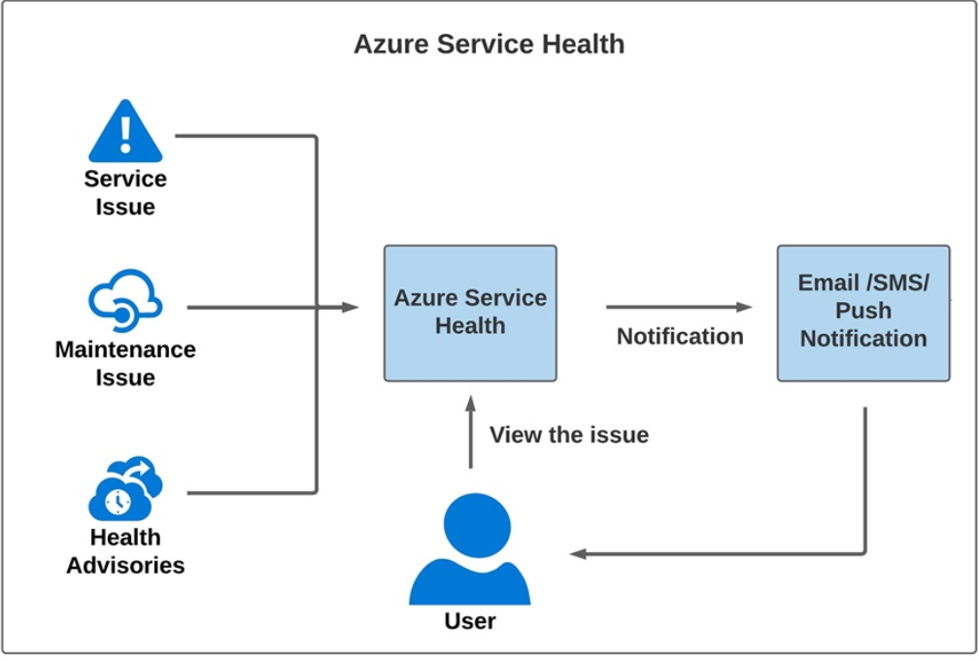
Azure Service Health
Personalized alerts and guidance for Azure Services issues
Set up Service health alerts through Email, SMS, push notifications
Azure Service health can only inform (Cannot prevent failure)
Azure Status > Azure Service Health > Azure Resource Health
Notes:
Azure Status : Global view of the health of Azure services and regions
Azure Service Health : Personalized dashboard based on your Azure usage
Azure Resource Health : Provides information about the health of your individual cloud resources
such a specific virtual machine instance

Slide 28
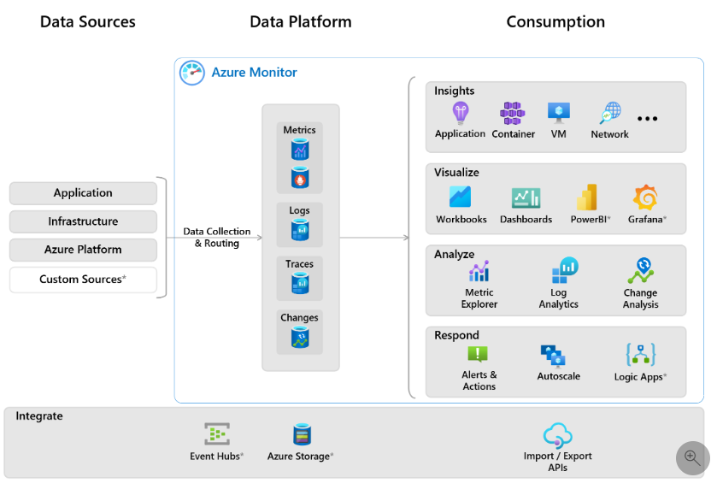
Azure Monitor
It is a platform for collecting data on your resources, analyzing that data,
visualizing the information, and
even acting on the results.
Azure Monitor can monitor Azure resources, your on-premises resources and even multi-cloud resources like VM hosted
with a different cloud provider.
Notes:
Gather ,analyze and visualize logs and metrics
From Azure and on-premise resources
Monitor resources across multiple subscriptions
identify issues and trigger alerts/ automated actions
Monitor Azure Active directory logs

Slide 29
Things you can do with Azure Monitor
Application Insights : Detect & diagnose application issues
VM insights : Monitor performance & health of your VMs and VM scale sets
Container insights : Monitor performance of container workloads (AKS,ACI etc.)
Log Analytics : Trouble shoot issues using monitoring data extracted from logs
Create smart alerts (SMS, Emails)
Automatically send an alert if an Azure VM is stopped
Auto scale based on thresholds
Create visualizations with Azure dashboards

Slide 30
AZ 900 Exam details
Certification Name: AZ-900: Microsoft Azure Fundamentals Certification.
Exam Duration: 90 minutes
Number of Questions: 40-60
Passing Score: 70%
Exam Cost: 99 USD
Exam Topics | Weightage of Questions
Describe cloud concepts | 25-30%
Describe Azure architecture and services | 35-40%
Describe Azure management and governance | 30-35%

Slide 31
Q
A
Thank you

